Slide 1

PCG signal Analysis Using Adaptive Filtering Technique- B145
Project Member Details: Swapnil Maiti (RA2111004010283)
Deekshitha Adusumalli (RA2111004010290) Sahil Sharma(RA2011004010252)
Project Guide: Dr. S. Hannah Pauline

Slide 2
Introduction
Phonocardiogram (PCG) signals are recordings of the sounds produced by the heart, typically captured using a stethoscope or a specialized microphone.
These signals provide critical information about the heart’s mechanical activity, such as the opening and closing of valves and blood flow dynamics and is used in diagnosing and monitoring heart conditions, including valve disorders and heart murmurs.
By analysing the distinct sounds within the PCG—through digital signal processing techniques that examine the timing, frequency, and intensity of heart sounds—medical professionals can accurately identify and interpret cardiac events.

Slide 3
However, PCG signals are susceptible to noise from various sources, including environmental sounds, body movements, electronic interference, and respiratory noises.
This noise can significantly affect the accuracy and reliability of PCG analysis.
Interference can lead to misinterpretation of heart sounds, potentially resulting in misdiagnosis or overlooked conditions.
Therefore, implementing effective noise reduction techniques, such as filtering and adaptive noise cancellation, is essential to maintain the clarity and usability of PCG signals for precise cardiac assessments.

Slide 4
Motivation & Objectives of the work
Accurate Diagnosis: PCG signals are used to diagnose various heart conditions. Noise can obscure important features in these signals, leading to misdiagnosis or missed diagnosis.
Improved Signal Quality: Noise reduction enhances the clarity of the heart sounds, making it easier for clinicians and automated systems to analyze them.
Reliable Feature Extraction: Many diagnostic algorithms rely on extracting features from PCG signals. Noise can interfere with the accuracy of these features.
Automation: Automated systems for heart sound analysis require clean signals for robust performance. Noise can cause these systems to fail or produce unreliable results.

Slide 5
Objective
Objective of this work is to develop an adaptive filter configuration for noise cancellation that achieves high SNR with low estimation error using a simple algorithmic approach, we propose a multi-stage feed-forward switched adaptive filter model for ANC systems.
The novelty lies in the automatic adjustment of the number of filter stages to optimize performance, coupled with switching between two signed LMS algorithms for the filter at each stage.

Slide 6
Literature Review
1. "Adaptive Filtering for Noise Cancellation: Algorithms and Applications"
Authors: Simon Haykin
Inference: This paper provides an extensive review of adaptive filter algorithms with a focus on noise cancellation applications. It covers the Least Mean Squares (LMS) algorithm, Recursive Least Squares (RLS) algorithm, and their variations.

Slide 7
Literature Review
2.Pauline, S.H., Dhanalakshmi, S.: A low-cost automatic switched adaptive filtering technique for denoising impaired speech signals. Multidimensional Systems and Signal Processing 33, 1387-1408 (2022).
Inference: The proposed adaptive filter model, which combines LMS and NLMS algorithms, effectively reduces noise in speech signals, particularly those affected by Parkinson's disease. This model outperforms existing filters by significantly improving SNR, MSE, and PSNR, offering a cost-effective solution for adaptive noise cancellation with high accuracy.

Slide 8
3. "Performance Analysis of Adaptive Filters for Noise Cancellation in Various Environments"
Authors: S. Shahidi, M. Mirzaei
Inference: The paper discusses the performance of different adaptive filter algorithms in various noise environments, providing a comparative study on their effectiveness.
Published in: IEEE Transactions on Signal Processing
DOI: 10.1109/TSP.2006.870888

Slide 9
Problem Statement
Traditional adaptive filters for noise cancellation face challenges in achieving high SNR with low estimation error, slow convergence, and instability. Existing fixed-stage filters lack adaptability to varying noise environments, limiting performance.
Problem statement is to develop a multi-stage feed-forward adaptive filter that: Automatically adjusts the number of filter stages for optimal performance. Switches between two signed LMS algorithms to balance noise reduction and convergence speed.
This work aims to enhance noise cancellation efficiency and adaptability in diverse applications.

Slide 10
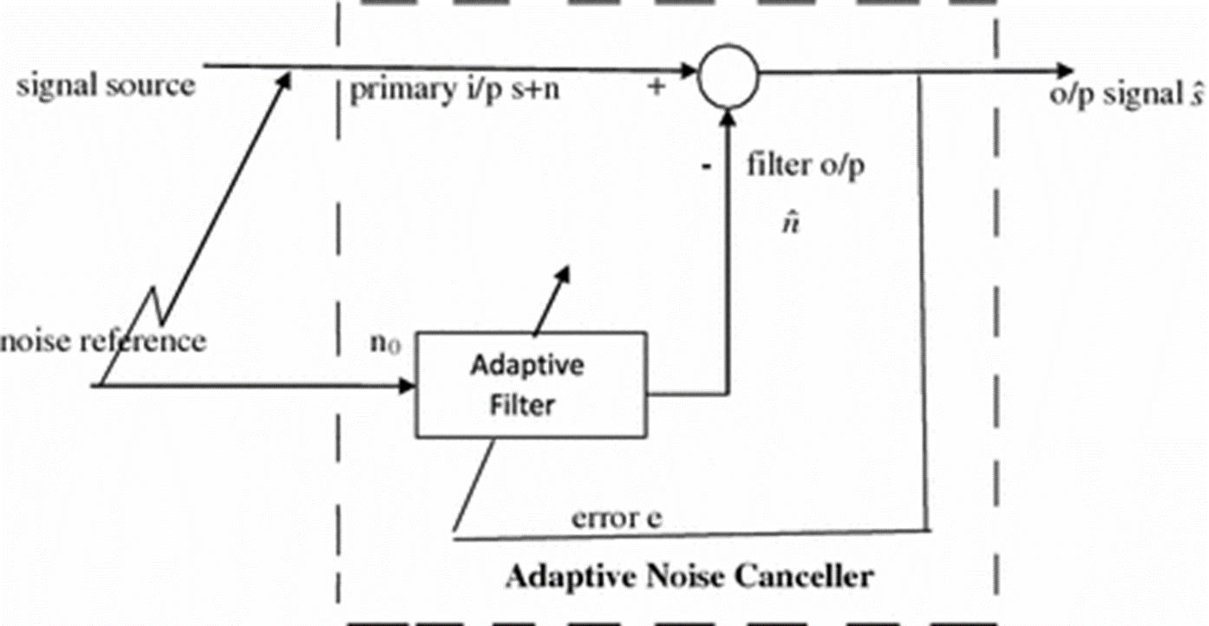
Block Diagram of Adaptive Filter

Slide 11
Realistic Constraints
Adaptive filters may converge slowly, especially if the initial filter coefficients are far from the optimal solution.
The stability of adaptive filters can be sensitive to the choice of step size (learning rate) and the input signal properties.

Slide 12

Time & Action Plan (Gantt Chart)
Minor Project Timeline (B154)

Slide 13
References
1. H. Deng and M. Doroslovacki, "A New Adaptive Noise Cancellation Scheme for Speech Enhancement," IEEE Transactions on Signal Processing, vol. 53, no. 7, pp. 2341-2351, July 2005, doi: 10.1109/TSP.2004.831255.
2. Yang Liu, A Noise Reduction Method Based on LMS Adaptive Filter of Audio Signals, 3rd International Conference on Multimedia Technology, ICMT, 2013.
3. S. Shahidi and M. Mirzaei, "Performance Analysis of Adaptive Filters for Noise Cancellation in Various Environments," IEEE Transactions on Signal Processing, vol. 54, no. 8, pp. 2952-2962, Aug. 2006, doi: 10.1109/TSP.2006.870888

